Slide 1

Web Application for Storing and Administrating a Movie Collection
Coordinator:
phD lecturer Maria Muntean
assist. prof. Liana Luminița Boca
Musteață Andrei, Mircea Adrian

Slide 2

Table of Contents
Introduction
Project’s purpose
Database Model
Building the BACKEND Rest API
Express Route
FrontEnd Interface
Client Side – HTPP Requests
Conclusion
Bibliography

Slide 3
Introduction
FRONT END
part of a website that the user interacts with directly
the ‘client side’ of the application
it includes everything that users experience directly:
text colors and styles
images
graphs and tables
buttons
colors
navigation menu
the languages used for Front End development
HTML
CSS
JavaScript
Notes:
The part of a website that the user interacts with directly is termed the front end. It is also referred to as the ‘client side’ of the application. It includes everything that users experience directly: text colors and styles, images, graphs and tables, buttons, colors, and navigation menu. HTML, CSS, and JavaScript are the languages used for Front End development.

Slide 4
Introduction
BACKEND
the server-side of the website
stores and arranges data
makes sure everything on the client-side of the website works fine
the part of the website that you cannot see and interact with
the portion of software that does not come in direct contact with the users
the parts and characteristics developed by backend designers are indirectly accessed by users through a front-end application
activities like writing APIs, creating libraries, and working with system components without user interfaces or even systems of scientific programming, are also included in the backend.
Notes:
Backend is the server-side of the website. It stores and arranges data, and also makes sure everything on the client-side of the website works fine. It is the part of the website that you cannot see and interact with. It is the portion of software that does not come in direct contact with the users. The parts and characteristics developed by backend designers are indirectly accessed by users through a front-end application. Activities, like writing APIs, creating libraries, and working with system components without user interfaces or even systems of scientific programming, are also included in the backend.

Slide 5
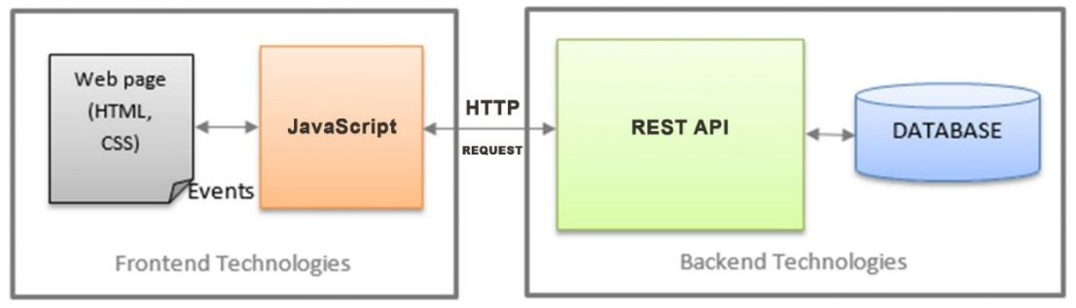
Project’s purpose
Goals:
to develop an online movie library
to analize and present the main steps in developing
The client or web interface is accessible through the browser and movies are being stored in a Mysql database via a RESTfull API.

Slide 6
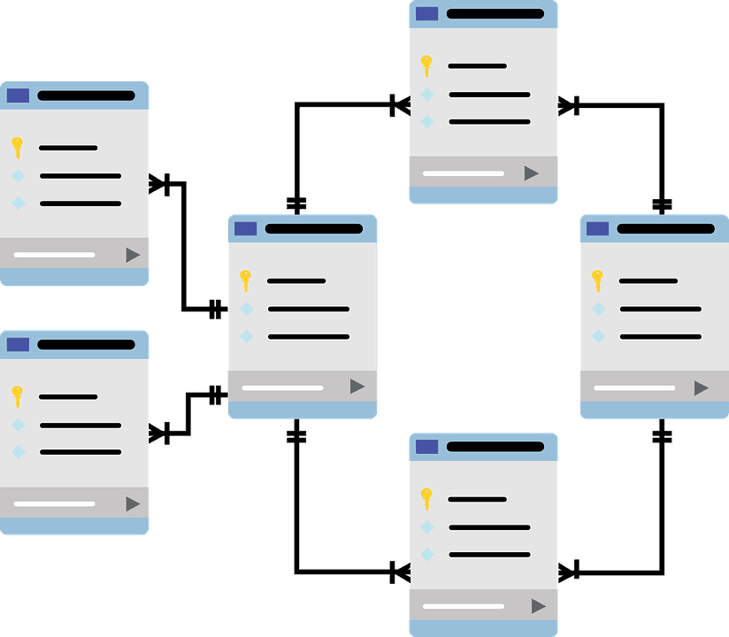
Database Model
Step 1
Step 1:
build the Mysql Database
we store all the info related to our application
each movie includes details
movie name
description
release year
poster
movie duration
trailer
rating
imdb_link
movie genre.
Notes:
First we will build the Mysql Database, here we store all the info related to our application. Each movie includes details such as movie name, description, release year, poster, movie duration, trailer, rating, imdb_link and movie genre. Because our database is Mysql we can manage and interogate data with SQL (a programming language that enables us to work with that data)

Slide 7
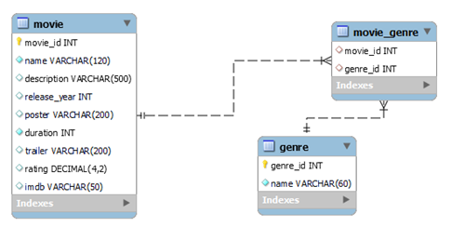
Database Model
Step 1:
we can manage and interrogate data with SQL (a programming language that enables us to work with that data)
database diagram
Notes:
First we will build the Mysql Database, here we store all the info related to our application. Each movie includes details such as movie name, description, release year, poster, movie duration, trailer, rating, imdb_link and movie genre. Because our database is Mysql we can manage and interogate data with SQL (a programming language that enables us to work with that data)

Slide 8
Building the BACKEND Rest API
Step 2
Step 2:
MySQL databases can only store data
If we want to do something with that data, a REST API makes it possible.
What is REST API?
REST is a method of building and using programs so that they can interact with each other. Without such guidelines, one program could not take information from another and use it.
our REST API will allow the frontend interface/client to communicate and manage our database.
Modules used dor building API:
Express.js
BodyParser
Cors
Main application's code / REST API with Express const express = require('express');
const bodyParser = require('body-parser');
const app = express();
const config = require('./config');
const movieRouter = require("./routes/movie");
const cors = require('cors');
app.use(cors({ origin: '*', optionsSuccessStatus: 200 }));
app.use(bodyParser.json());
app.use(bodyParser.urlencoded({ extended: true }));
app.use("/", movieRouter);
app.use("/movies", movieRouter);
app.use("/movie", movieRouter);
app.use((err, req, res, next) => {
const statusCode = err.statusCode || 500;
console.error(err.message, err.stack);
res.status(statusCode).json({ message: err.message });
});
app.listen(config.PORT, () => console.log(`Server is running at port ${config.PORT}`));

Slide 9
Express Route
Step 2
movieRouter - an express route.
refers to how an application’s endpoints (URIs) respond to client request.
Following code we have defined routing using methods of the Express app object that correspond to HTTP methods:
router.get() to handle GET requests – to get all the movies
router.post() to handle POST requests – to add a movie
router.delete() to handle DELETE requests – to delete a movie
When the client makes a GET request on the endpoint "…/movie(s)" the server will execute the code wich is found here in MovieRouter. If the endpoint is "/movie/delete" the server will execute the function related to "/delete" endpoint.
MovieRouter / EXEMPLE OF GETTING ALL THE MOVIES
const express = require('express');
const router = express.Router();
const db = require('../db');
function emptyOrRows(rows){…}
async function addMovie(movie) {…}
async function updateMovie(movie) {…}
async function deleteMovie({ movie_id }){…}
async function getMovies() {
const rows = await db.query(
`SELECT movie.movie_id, movie.name, description, release_year, poster, duration, trailer, rating, imdb, GROUP_CONCAT(genre.name) AS 'genre' FROM movie
JOIN movie_genre on movie.movie_id = movie_genre.movie_id
JOIN genre on movie_genre.genre_id = genre.genre_id
GROUP by movie.movie_id
ORDER BY movie.movie_id DESC;`
);
const data = emptyOrRows(rows);
return { data }
}
router.get('/', async function (req, res, next) {…}
router.put('/update', async function (req, res, next) {…}
router.delete('/delete', async function (req, res, next){…}
module.exports = router;

Slide 10
Express Route
Step 2
If we look at the example above the expanded function router.get ('/', … refers to the endpoint "/movie/".
all the code inside will be executed.
This function will call getMovies() wich basically executes an SQL querry to get all the movies from the database.res.json send the resul to the client in a JSON format
router.get('/', async function (req, res, next) {
try {
const movies = await getMovies(req.query.page);
res.json({ movies: movies.data });
} catch (err) {
console.error(`Error while getting movies `, err.message);
next(err);
}
});
router.put('/update', async function (req, res, next) {…}
router.delete('/delete', async function (req, res, next){…}
module.exports = router;

Slide 11
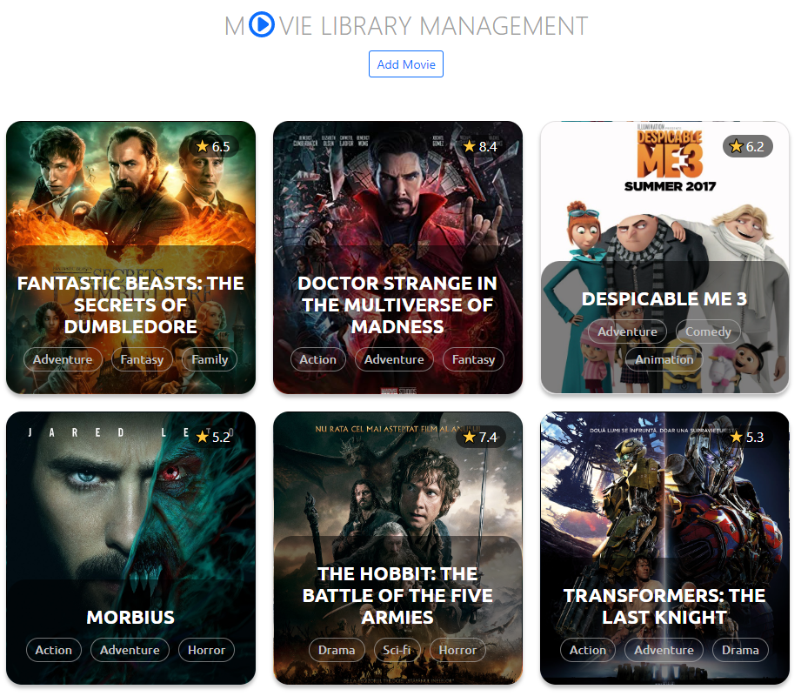
FrontEnd Interface
Step 2
In building the website interface we've used:
Html - language that determines how documents and web pages are displayed in a web browser
Css - a popular style sheet language that determines how a document created in HTML is styled (colors, font styles, layout and responsive features).
Javascript – allows you to change CSS and HTML elements on your website after the site has been loaded, which gives you the ability to make your site more interactive and engaging for
users.

Slide 12
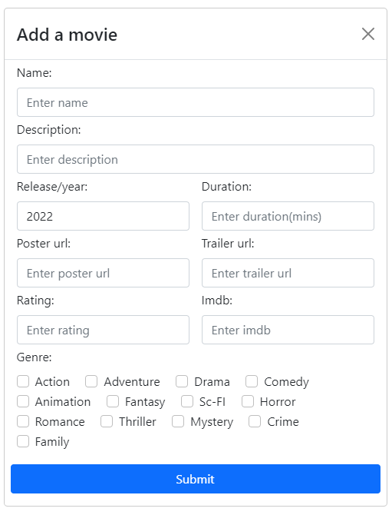
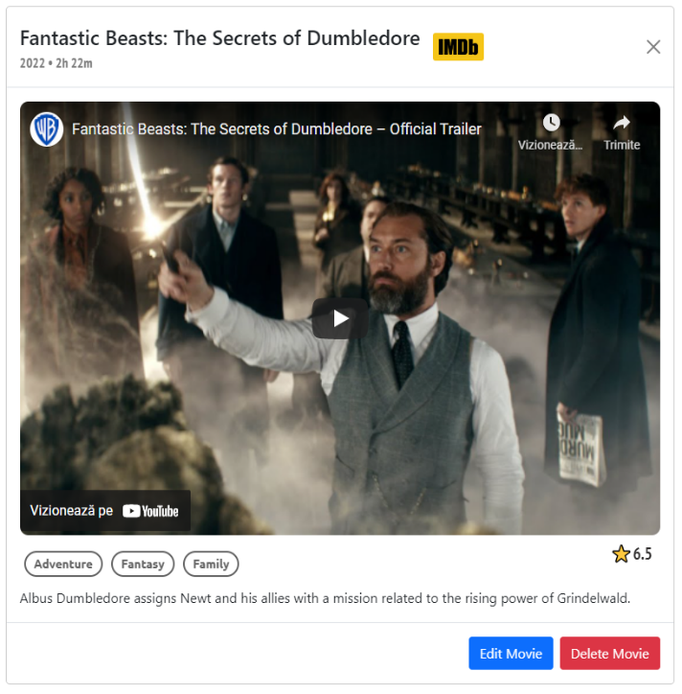
FrontEnd Interface
Step 2
Add Movie Modal – is that part where the client is allowed to add a new movie to the library. The information from dialog's form is being send to the backend api and then processed to be saved into database. Edit Movie Modal acts similar, but it allows us to edit a movie already created.
Movie Info Modal – By selecting a movie a popup will show up with more details, including release year, movie trailer and description. For more info you can go straight to imdb offical site by clicking on that specific logo next to the name

Slide 13
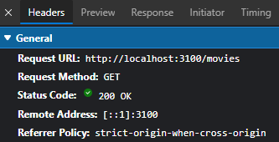
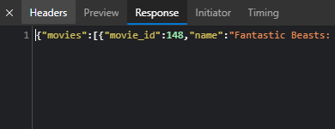
Client Side – HTPP Requests
Step 2
In order to pass the information from frontend modals to backend api we have to use HTTP request.
this is how we will communicate with.
our frontend contains 4 of these HTTP requests:
GET REQUEST for getting all the movies
POST REQUEST for adding a movie
PUT REQUEST for editing a movie
DELETE REQUEST for deleting a movie

Slide 14
Conclusion
was a lot of work on both sides' frontend and backend.
very different technologies and both of them needs to function properly otherwise the application is down
this was just an example of how these 2 "players" connects in order to serve application's objective
in production there is one team that works with frontend and another team with backend.
both teams have the same goal to connect their work together and deliver a complete functional website.
Notes:
We did it! Our application is running live. There was a lot of work on both sides frontend and backend. They are very different technologies and both of them needs to function properly otherwise the application is down. This was just an example of how these 2 "players" connects together in order to serve application's objective. In production there is one team that works with frontend and another team with backend. Both teams having the same goal to connect their work together and deliver a complete functional website.

Slide 15
Bibliography
Frontend vs Backend – GeeksforGeeks
Express.js (tutorialsteacher.com)
HTTP requests - IBM Documentation

Slide 16

Thank you!
Questions?

